Slide 1
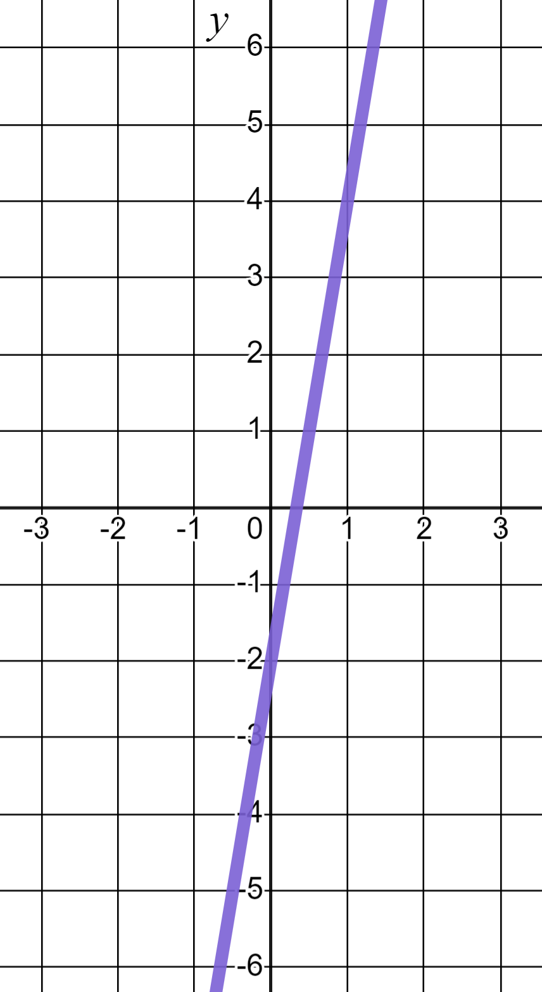
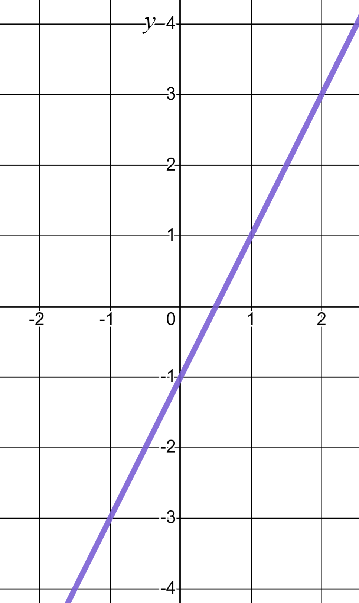
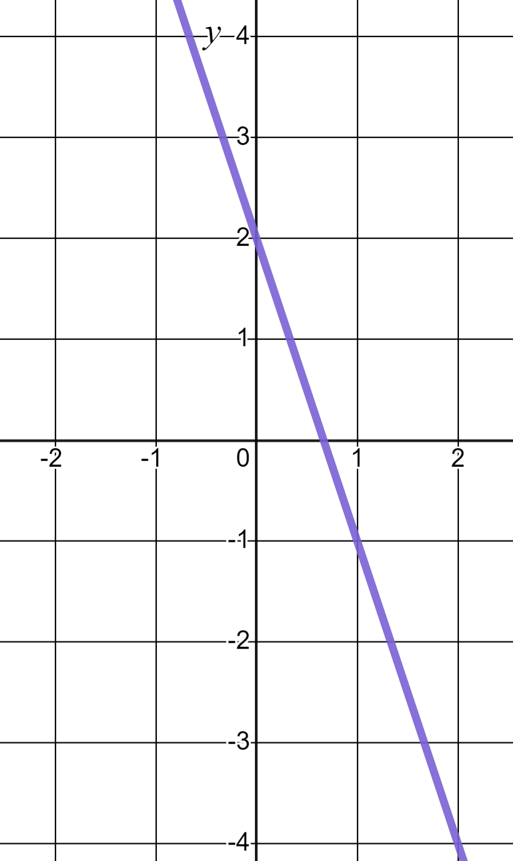
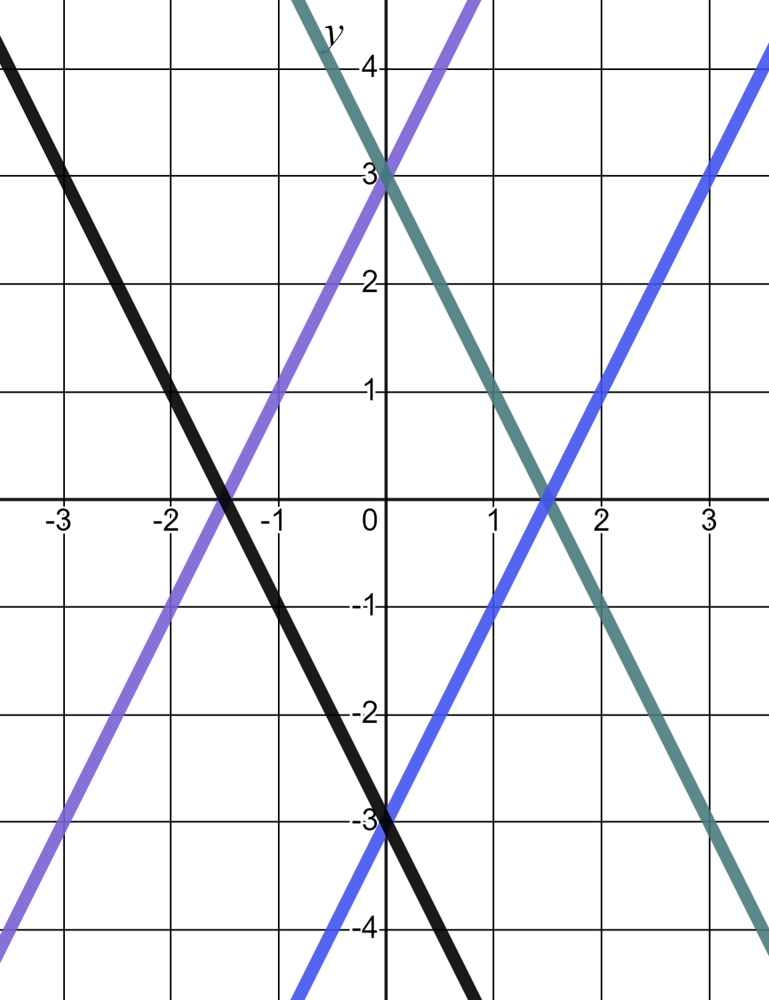
Equations and their graphs
Task A: Reviewing features of linear graphs
1) Gradient of 6 and a y-intercept of (0, −2) is a description unique to graph (a). Write descriptions for b) and c)
a)
b)
c)
2) Match the linear equations to their respective lines.
a) y = 2x + 3
b) y = 3 − 2x
c) y = −3 − 2x
d) y = 2x − 3

Slide 2
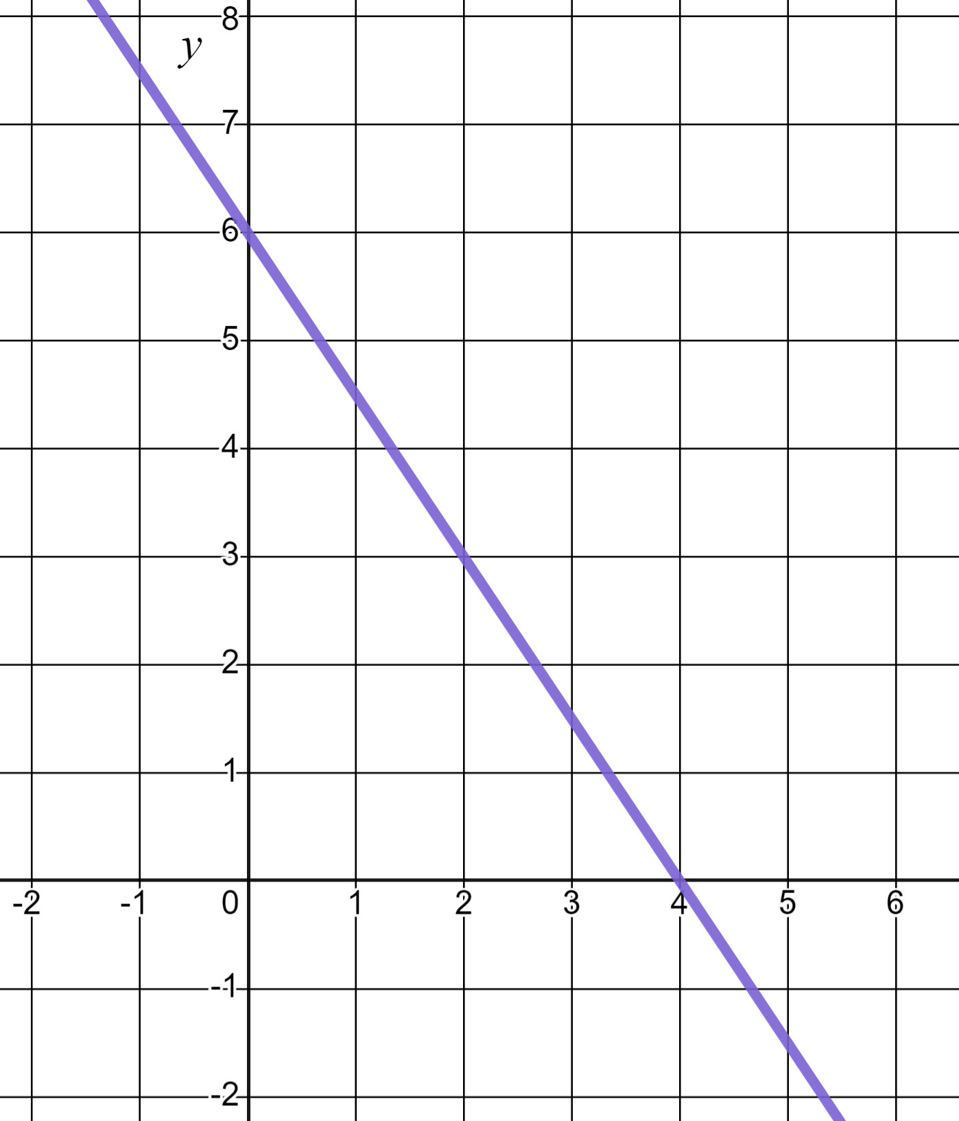
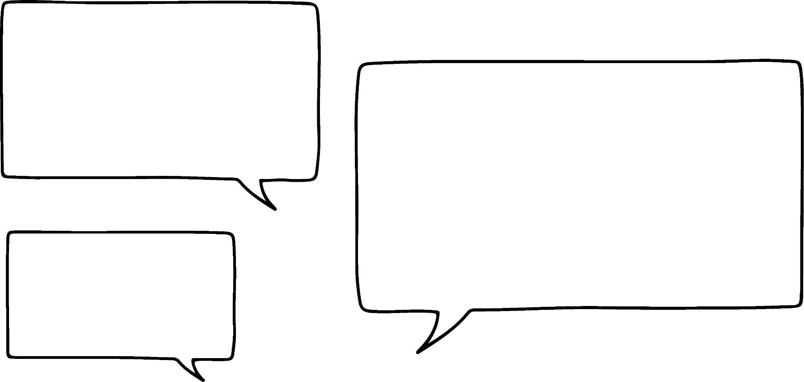
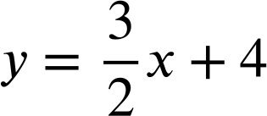

Equations and their graphs
3) Laura is writing the equation of this linear graph.
2
I see a change of 3 in y and a change of 2 in x and and intercept of 4 so this is the line
3
✖
Write at least two sentences to explain Laura’s errors to her. You may choose to annotate the graph in your explanation.

Slide 3

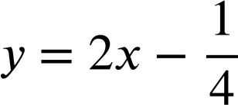
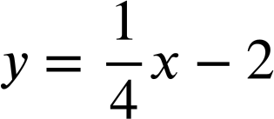
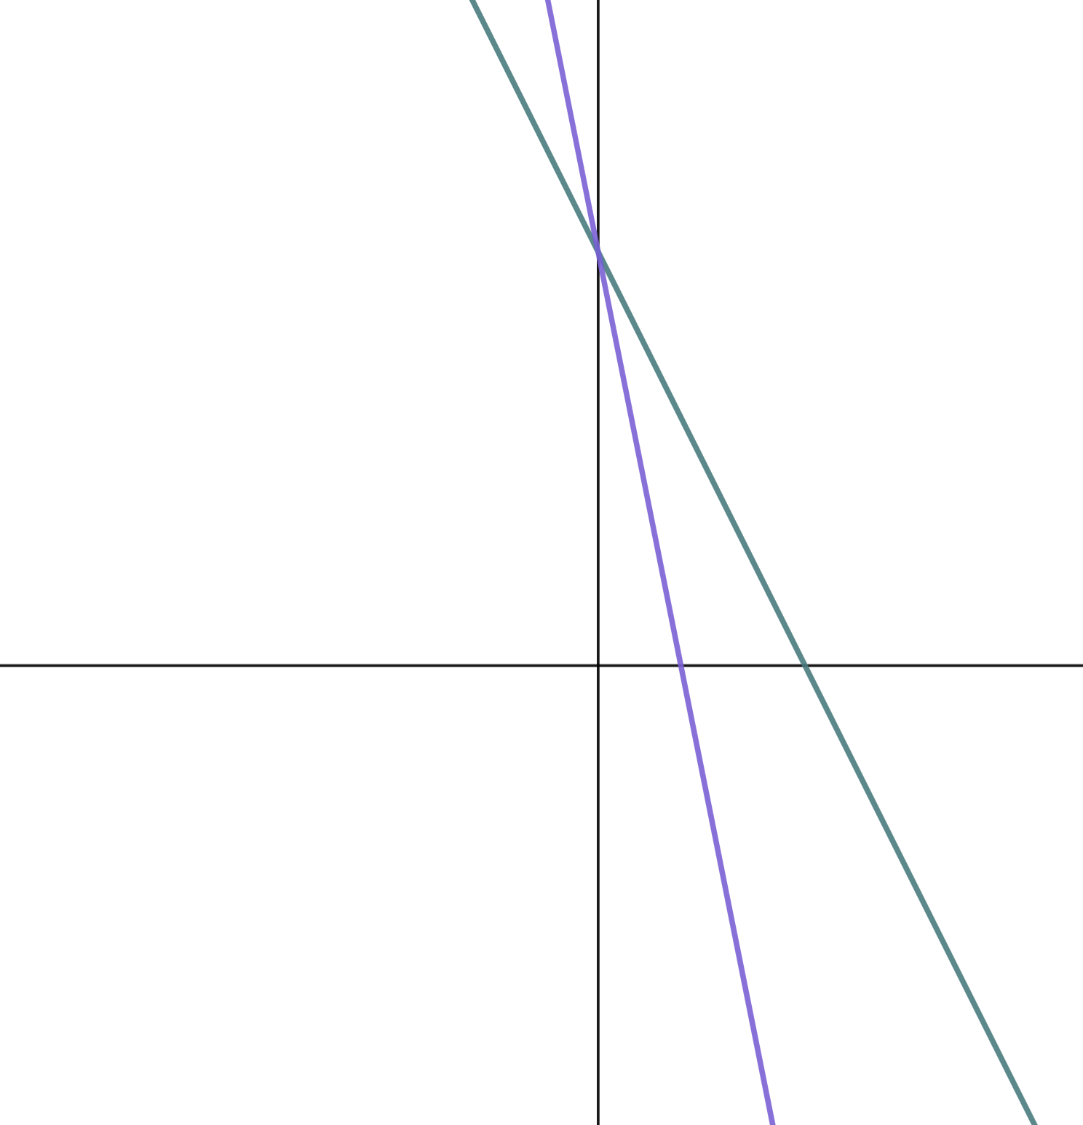
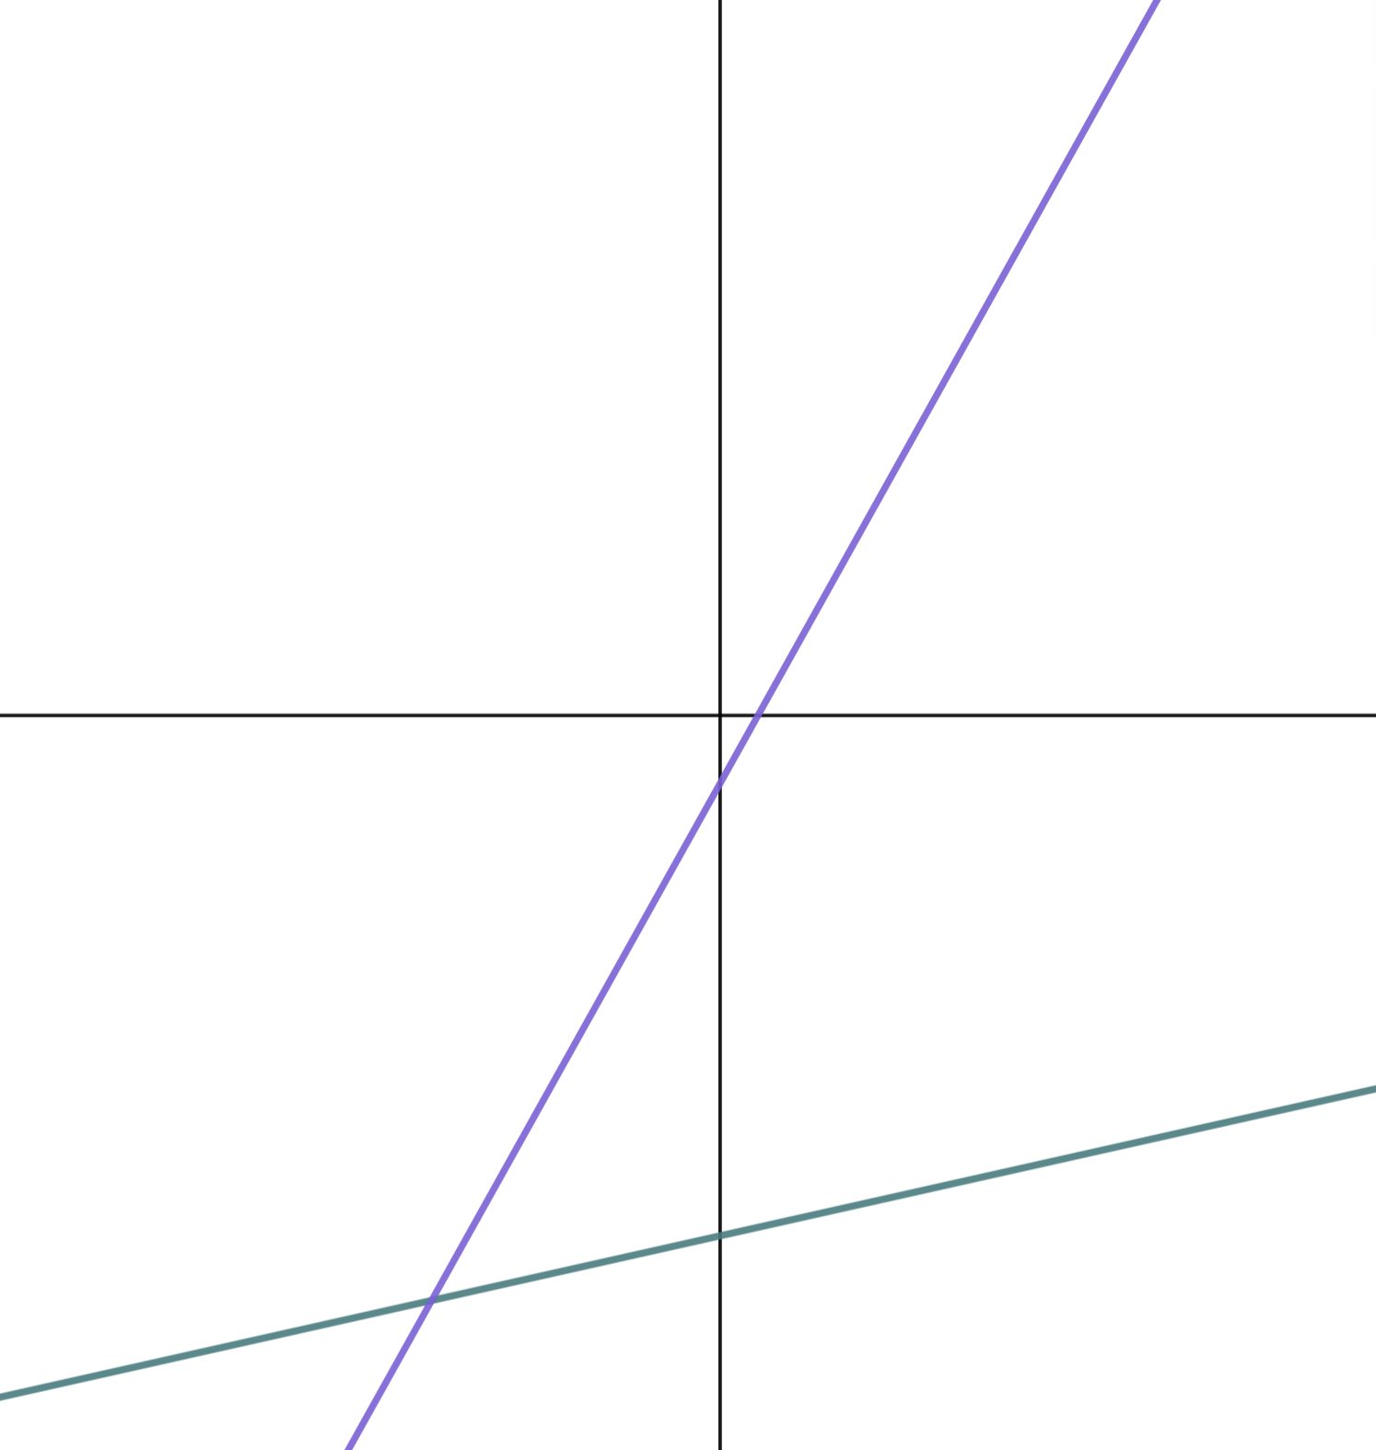
Equations and their graphs
Task B: Sketching linear graphs
1) Sketch the lines y = 2x + 10, y = 5 − 4x, and y = 2x − 5 on the below axes.
y
x
2) Match the linear equations to their respective lines.
a)
b) y = 18 − 2x
c) y = −5x + 18
d)
y
y
x
x
Mathematics in Education and Industry
v2.3

